Slide 1
Previous Class Test Diagram

Slide 2
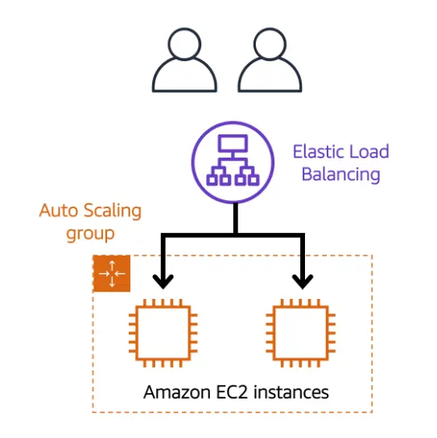
Auto Scaling

Slide 3
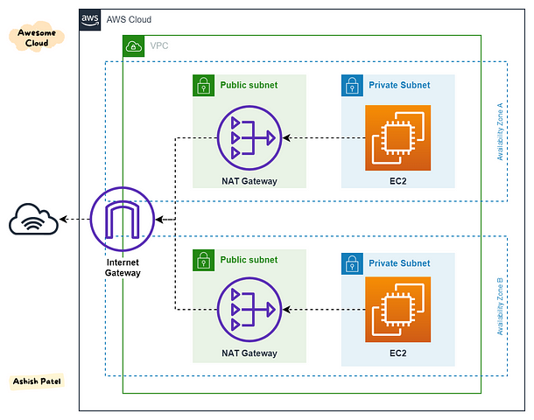
VPC

Slide 4
Virtualization: Future of Computing
A deep dive into the concepts, types, and applications of virtualization.

Slide 5
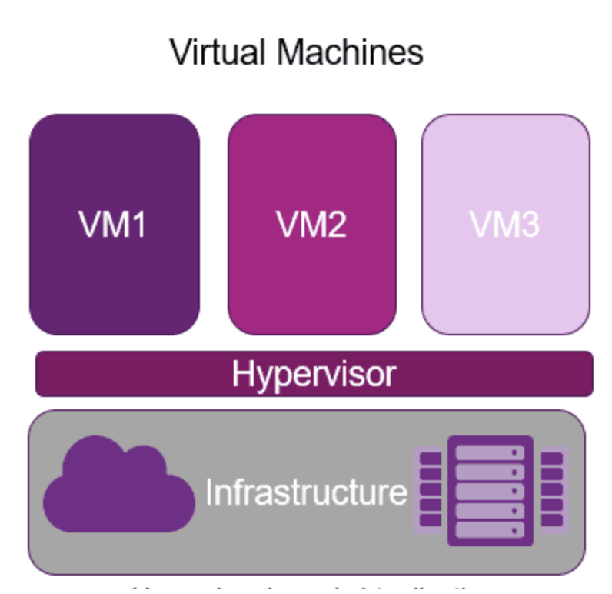
Introduction to Virtualization
Virtualization is the process of creating a virtual version of computing resources such as servers, storage devices, networks, or even operating systems.
Key Benefits:
Improved resource utilization.
Reduced IT costs.
Enhanced flexibility and scalability.

Slide 6
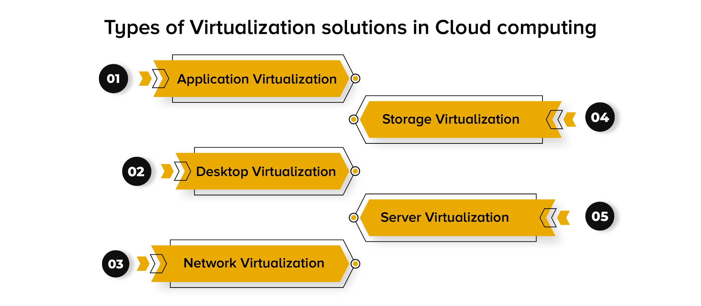

Slide 7
Types of Virtualization
1. Server Virtualization: Partitioning a physical server into multiple virtual servers.
2. Desktop Virtualization: Allows users to access desktops remotely.
3. Network Virtualization: Combines hardware and software network resources into a single, software-based entity.
4. Storage Virtualization: Pools physical storage resources into a single virtual resource.

Slide 8
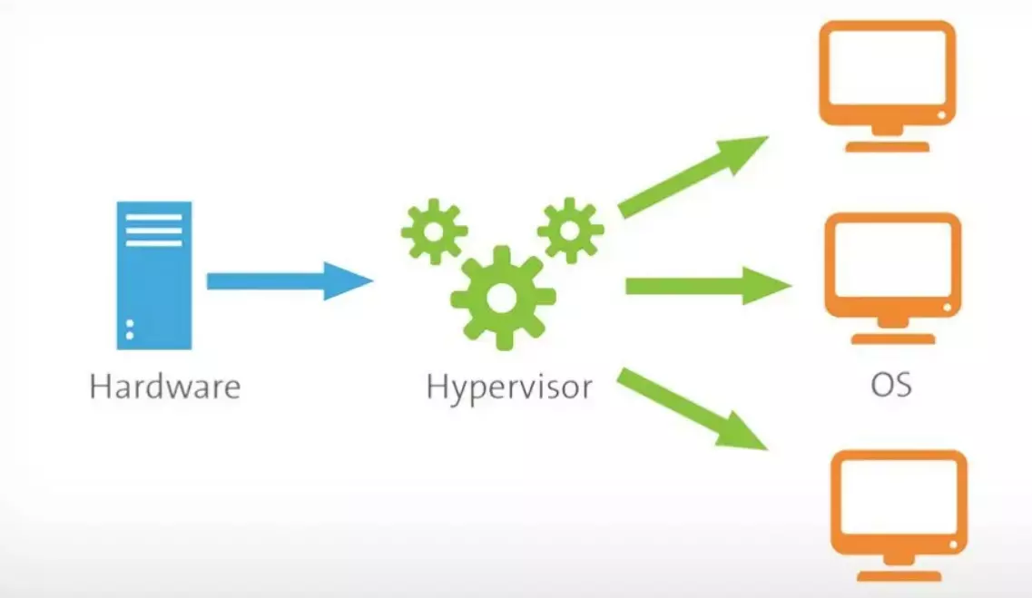
What is Hypervisor?
A hypervisor, also known as a virtual machine monitor (VMM) or virtualizer, is a type of computer software, firmware or hardware that creates and runs virtual machines.

Slide 9
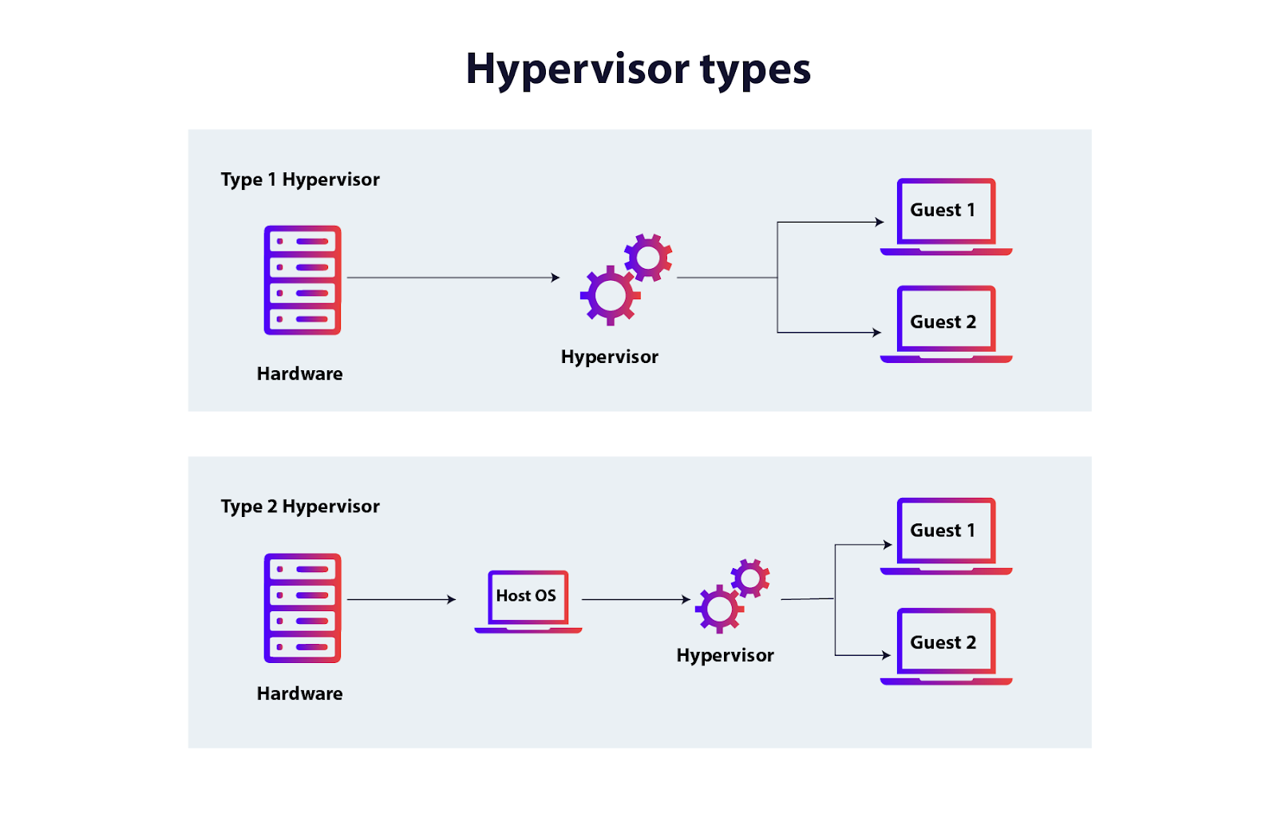

Slide 10
How Virtualization Works
Core Components:
Hypervisor: Software that creates and manages virtual machines (VMs).
Guest OS: The operating system running inside the VM.
Host OS: The operating system managing the physical hardware.
Types of Hypervisors:
Type 1: Runs directly on hardware (e.g., VMware ESXi).
Type 2: Runs on a host operating system (e.g., VirtualBox).

Slide 11
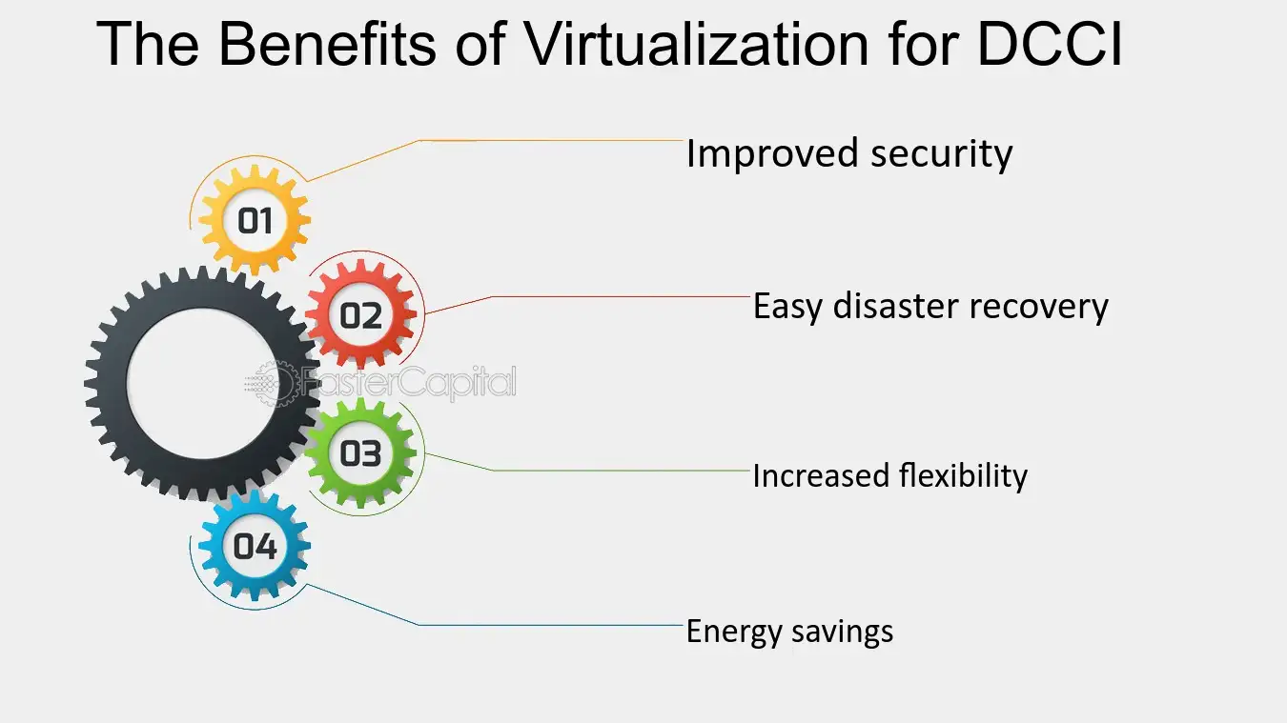
Advantages of Virtualization
Data Center Consolidation initiative
Cost Savings:
Lower hardware requirements.
Reduced energy consumption.
Flexibility:
Easy migration of workloads.
Scalability.
Improved Disaster Recovery:
Backups and snapshots.

Slide 12
Challenges of Virtualization
Initial Costs: Higher upfront costs for setup.
Complexity: Requires expertise for configuration and maintenance.
Performance Overhead: Potential decrease in performance due to resource sharing.
Security Concerns: Risks like VM escape and hypervisor attacks.

Slide 13
Applications of Virtualization
Cloud Computing: Foundation for services like IaaS, PaaS, and SaaS.
Development and Testing: Isolated environments for software development.
Disaster Recovery: Quick restoration of systems.
Education and Training: Virtual labs and simulations.

Slide 14
Future of Virtualization
Emerging Trends:
Containerization (e.g., Docker, Kubernetes).
Edge Computing.
Virtual Reality (VR) and Augmented Reality (AR).
Impact: Greater focus on scalability, speed, and efficiency.

Slide 15
Summary
Virtualization transforms IT infrastructure by optimizing resource utilization, reducing costs, and improving scalability.
Key types include server, storage, network, and desktop virtualization.
Challenges like security risks and complexity need to be managed effectively.

